Slide 1
Oral Enalish Presentation Skills
International Friends Project
Professor Thayer
Eason
Student lD 3123358222
Spring Semester 2024

Slide 2
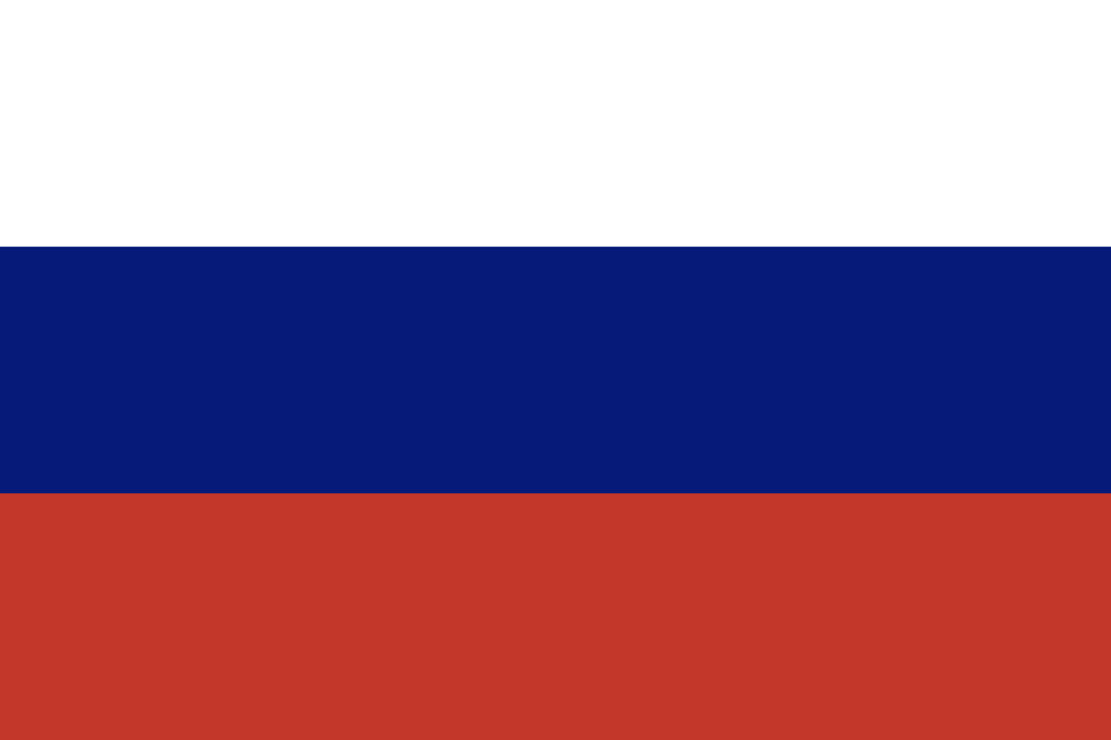
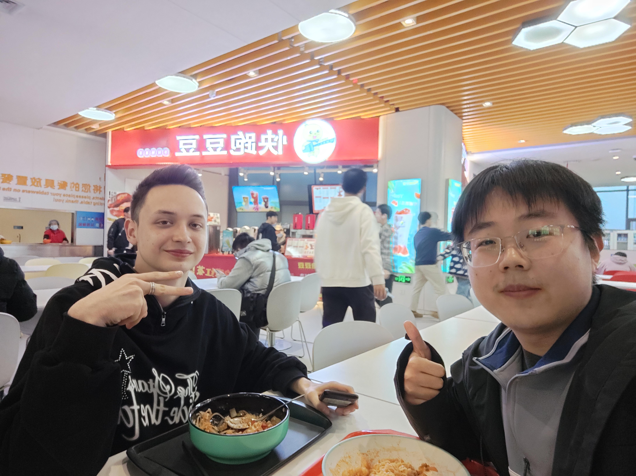
My International Friend at Innovation Harbor
My friend Oleg is a 17-year-old student from Moscow, Russia. He arrived here last October but only stayed for a few months before moving on to Beijing.
He majors in computer science, just like me. Interestingly, he speaks Chinese with his tutor, which really surprised me. We discussed food, and he mentioned that the local cuisine here is a bit spicy for his taste, as Russians generally prefer sweet flavors. Oleg has traveled to many places in Xi'an and Chongqing with his Russian friends, but he also enjoys playing basketball with some Chinese friends. He informed me that there is a significant number of Russian students here.
In his daily life, Oleg occasionally plays video games, but he prefers exploring the city over gaming. Finally, we exchanged our WeChat details.

Slide 3
Personal reflection
From this project, I didn't just finish some work, but also made a friend from another country. At first, I felt nervous about talking to someone new, especially someone who wasn't from around here. The different languages and customs, and not knowing what to expect, made saying 'hi' seem really hard. But after I took a moment to calm down and forced myself to try something new, I said that first 'hi,' and it led to lots of cool experiences.
Having a friend from a different place is great because they bring a lot of variety into our lives. They show us their own special stories, ways of doing things, and ways of thinking that are different from ours. Their home has its own unique features and past that shapes how they see the world. Their traditions and habits give us a glimpse into a lifestyle we might have only heard about or seen in films.
Chatting with someone from another country can also be a way to connect. Even if we don't speak the same language, trying to understand each other shows how strong friendship can be. We both learn and grow by picking up new words and sayings, which makes our language skills better and helps us see how amazing language can be.
A friend from far away is more than just a friend; they're like a tour guide to places we've never been. They help us see things in a new way, teaching us about the world and different viewpoints that make us think differently. They help us see how big the world is and how we're all connected.
To sum it up, making a friend from another country is like being invited on an adventure. It's a chance to learn more, to celebrate the things that make us different as people and as groups. It's a way to leave our comfort zones and have real conversations that can bring us closer and help us understand each other better. It's an experience that can change how we see the world and make us kinder, more open people who care about everyone.

